Slide 1

Lecture 14
Applications of priority queues: sorting
http://xkcd.com/835/
EECS-214

Slide 2

Priority queues
Like normal queues
  Objects wait in line to be processed
However, items have an associated numeric priority
  Priority specified when added to queue
  Objects removed from queue in order of priority
Slightly different API
  Insert(object, priority)
    Adds object with specified priority
  ExtractMax()
    Returns highest priority object

Slide 3
Priority queues
Like normal queues
  Objects wait in line to be processed
However, items have an associated numeric priority
  Priority specified when added to queue
  Objects removed from queue in order of priority
Slightly different API
  Insert(object, priority)
    Adds object with specified priority
  ExtractMin()
    “Min priority queue”
    Returns lowest priority object
    Except that in most applications, we usually want the lower “priorities” first

Slide 4
Heaps
9
Heaps are a simple tree structure for implementing priority queues
Rather than requiring their in-order traveral to be sorted
  We just require that parent nodes be larger than their child nodes
There are lots of exotic types of heaps
  We’ll focus on binary heaps
  Which are complete binary trees with the heap property
  We’ll get to the completeness thing in a minute…
7
8
1
6
4
5
3
2

Slide 5
Heaps
9
Proposition: the largest element of a heap is always its root
Proof:
Suppose some other element is the largest element
Since it isn’t the root, it must have a parent
Since it’s the largest element, it must be larger than its parent
But that contradicts the definition of a heap
So the largest element must be the root
7
8
1
6
4
5
3
2

Slide 6
Binary heaps
A binary heap is a
  Complete binary tree
  That satisfies the heap property
Great!
How do we ensure that the heap is a complete binary tree?
9
7
8
1
6

Slide 7
Embedding in an array
It turns out that any complete binary tree can be embedded an array in a particularly cleaver way
We can compute
  The position of its parent in the array,
  and the positions of its children,
  directly from its own position
9
7
8
1
6

Slide 8
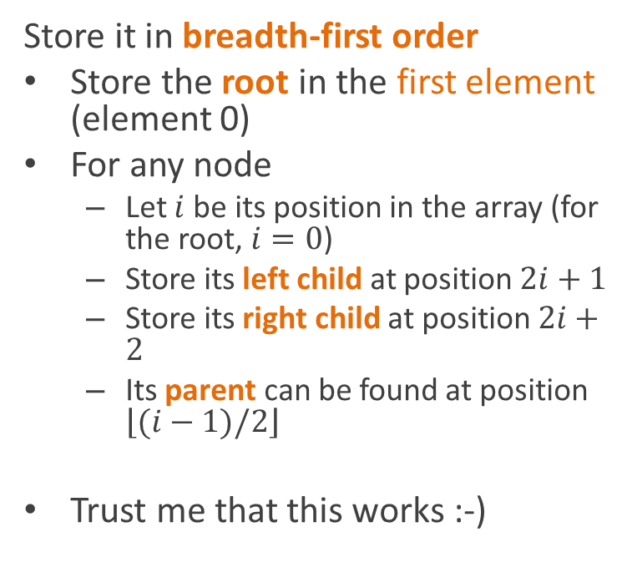
Embedding in an array
Store it in breadth-first order
Store the root in the first element (element 0)
For any node
  Let $i$ be its position in the array (for the root, $i=0$)
  Store its left child at position $2i+1$
  Store its right child at position $2i+2$
  Its parent can be found at position $\left\lfloor (i−1)/2\right\rfloor$
Trust me that this works :-)
9
7
8
1
6
9
7
8
1
6

Slide 9
Heap insertion using the array representation
HeapInsert(A, key)
i = A.size
A.size = A.size + 1
while i>0 and
A[Parent(i)] < key
A[i] = A[Parent(i)]
i = Parent(i)
A[i] = key
9
7
8
1
6
9
7
8
1
6

Slide 10
Extracting an element
HeapExtractMax(A)
max = A[0]
A[0] = A[A.size]
A.size--
Heapify(A,0)
return max
10
7
9
1
6
8
10
7
9
1
6
8

Slide 11
Extracting an element
Heapify(A, i)
l = Left(i)
r = Right(i)
if l≤A.size and A[l]>A[i]
largest = l
else
largest = i
if r≤A.size and A[r]>A[largest]
largest = r
if largest≠i
swap A[i] and A[largest]
Heapify(A, largest)
10
7
9
1
6
8
10
7
9
1
6
8

Slide 12
Sorting
[Pretend I had found some awesome clipart about sorting here]
Priority queues can be used for sort algorithms
  Add all items to the queue
  Repeatedly extract max
    Or min, if it’s a min queue
  Write them in order

Slide 13
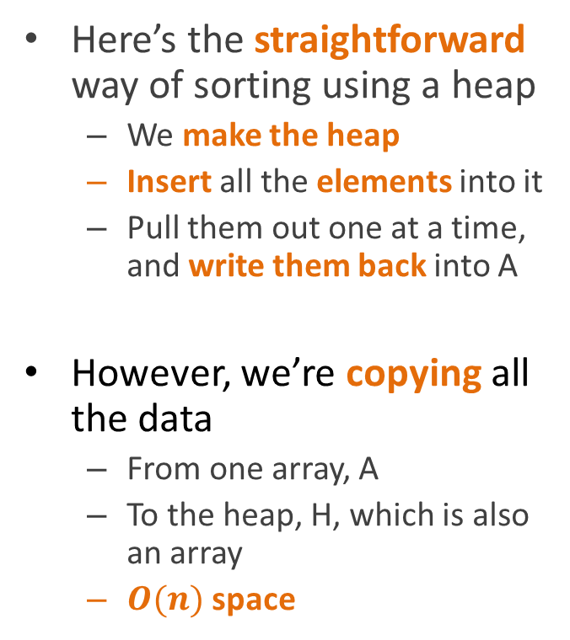
Version 1
Here’s the straightforward way of sorting using a heap
  We make the heap
  Insert all the elements into it
  Pull them out one at a time, and write them back into A
However, we’re copying all the data
  From one array, A
  To the heap, H, which is also an array
  $O(n)$ space
Heapsort(A)
H = new, empty heap
for each e in A
Insert(H, e)
for i = A.Length-1 to 0
A[i] = ExtractMax(H)

Slide 14
In-place heapsort
It would be cooler if we could build the heap inside A itself
How do we do that?
HeapSort(A)
H = new, empty heap
for each e in A
Insert(H, e)
for i = A.Length-1 to 0
A[i] = ExtractMax(H)

Slide 15
Sketch of in-place heap construction

Slide 16
Sketch of in-place heap construction
Start with the array
4
6
2
7
3
1
5

Slide 17
Sketch of in-place heap construction
4
Start with the array
Pretend that it’s a complete binary tree
It probably doesn’t satisfy the heap property
  i.e. there are probably nodes that are larger than their parents
6
2
7
3
1
5
4
6
2
7
3
1
5

Slide 18
Sketch of in-place heap construction
4
But we can think of each leaf as a little 1-element heap
  And they automatically satisfy the heap property
  Because the only have one element
6
2
7
3
1
5
4
6
2
7
3
1
5

Slide 19
Sketch of in-place heap construction
4
Now run heapify on each of their parents
Heapify
  Checks if the parent is larger that both children
6
2
7
3
1
5
4
6
2
7
3
1
5

Slide 20
Sketch of in-place heap construction
4
Now run heapify on each of their parents
Heapify
  Checks if the parent is larger that both children
  If not, it swaps it with the larger child
6
2
7
3
1
5
4
6
2
7
3
1
5

Slide 21
Sketch of in-place heap construction
4
Now we have
  A bunch of 2-level subtrees that
  Each satisfy the heap property
7
5
6
3
1
2
4
7
5
6
3
1
2

Slide 22
Sketch of in-place heap construction
4
Repeat at the next level
7
5
6
3
1
2
4
7
5
6
3
1
2

Slide 23
Sketch of in-place heap construction
7
Repeat at the next level
This may require Heapify to recurse
4
5
6
3
1
2
7
4
5
6
3
1
2

Slide 24
Sketch of in-place heap construction
7
Repeat at the next level
This may require Heapify to recurse
But when we’ve done every level
6
5
4
3
1
2
7
6
5
4
3
1
2

Slide 25
Sketch of in-place heap construction
7
Repeat at the next level
This may require Heapify to recurse
But when we’ve done every level
We’ve transformed the data, in-place, into a binary heap
6
5
4
3
1
2
7
6
5
4
3
1
2

Slide 26
Algorithm for in-place heap construction
The last half of the array is guaranteed to be leaves
  So we don’t have to do anything with it
BuildHeap(A)
for i = A.Length/2 to 0
Heapify(A, i, A.Length)

Slide 27
Algorithm for in-place heap construction
We want to call Heapify
  On every non-leaf node
  Starting at the bottom of the tree
  And moving upwards
Since lower parts of the tree are at the end of the array,
  All we have to do is start halfway through the array
  and move back
  Calling Heapify
BuildHeap(A)
for i = A.Length/2 to 0
Heapify(A, i, A.Length)

Slide 28
Version 2
Now this is really kind of cool
We build the heap in place
Then we loop
  Each iteration removes the maximal element
  That shrinks the heap
  Making room at the end of the array
  Which is where we would want to put the maximal element, anyway!
Heapsort(A)
BuildHeap(A)
for i = A.Length-1 to 1
A[i] = ExtractMax(A)

Slide 29
Completing the sort
7
ExtractMax
Grabs the maximal element, 7
6
5
4
3
1
2
7
6
5
4
3
1
2

Slide 30
Completing the sort
7
ExtractMax
Grabs the maximal element, 7
Replaces it with the last leaf, 2
6
5
4
3
1
2
7
6
5
4
3
1
2

Slide 31
Completing the sort
2
ExtractMax
Grabs the maximal element, 7
Replaces it with the last leaf, 2
And calls Heapify
6
5
4
3
1
2
6
5
4
3
1
2

Slide 32
Completing the sort
2
ExtractMax
Grabs the maximal element, 7
Replaces it with the last leaf, 2
And calls Heapify
6
5
4
3
1
2
6
5
4
3
1
2

Slide 33
Completing the sort
6
ExtractMax
Grabs the maximal element, 7
Replaces it with the last leaf, 2
And calls Heapify
2
5
4
3
1
6
2
5
4
3
1
2

Slide 34
Completing the sort
6
ExtractMax
Grabs the maximal element, 7
Replaces it with the last leaf, 2
And calls Heapify
4
5
2
3
1
6
4
5
2
3
1
2

Slide 35
Completing the sort
6
ExtractMax
Grabs the maximal element, 7
Replaces it with the last leaf, 2
And calls Heapify
  Thereby reestablishing the heap property
4
5
2
3
1
6
4
5
2
3
1
2

Slide 36
Completing the sort
6
ExtractMax
Grabs the maximal element, 7
Replaces it with the last leaf, 2
And calls Heapify
  Thereby reestablishing the heap property
And now we store 7 (the max) at the end of the array)
4
5
2
3
1
6
4
5
2
3
1
7

Slide 37
Completing the sort
6
Repeat
4
5
2
3
1
6
4
5
2
3
1
7

Slide 38
Completing the sort
6
Grab the max, 6
4
5
2
3
1
6
4
5
2
3
1
7

Slide 39
Completing the sort
6
Grab the max, 6
Replace it with the last leaf, 1
4
5
2
3
1
6
4
5
2
3
1
7

Slide 40
Completing the sort
1
Grab the max, 6
Replace it with the last leaf, 1
4
5
2
3
1
4
5
2
3
1
7

Slide 41
Completing the sort
1
Grab the max, 6
Replace it with the last leaf, 1
Heapify
4
5
2
3
1
4
5
2
3
1
7

Slide 42
Completing the sort
1
Grab the max, 6
Replace it with the last leaf, 1
Heapify
4
5
2
3
1
4
5
2
3
1
7

Slide 43
Completing the sort
5
Grab the max, 6
Replace it with the last leaf, 1
Heapify
4
1
2
3
5
4
1
2
3
1
7

Slide 44
Completing the sort
5
Grab the max, 6
Replace it with the last leaf, 1
Heapify
Store the max, 6, in the next-to-last slot
4
1
2
3
5
4
1
2
3
6
7

Slide 45
Completing the sort
5
Repeat
4
1
2
3
5
4
1
2
3
6
7

Slide 46
Completing the sort
5
Grab the max, 5
4
1
2
3
5
4
1
2
3
6
7

Slide 47
Completing the sort
5
Grab the max, 5
Replace with the last leaf, 3
4
1
2
3
5
4
1
2
3
6
7

Slide 48
Completing the sort
3
Grab the max, 5
Replace with the last leaf, 3
4
1
2
3
4
1
2
3
6
7

Slide 49
Completing the sort
3
Grab the max, 5
Replace with the last leaf, 3
Heapify
4
1
2
3
4
1
2
3
6
7

Slide 50
Completing the sort
3
Grab the max, 5
Replace with the last leaf, 3
Heapify
4
1
2
3
4
1
2
3
6
7

Slide 51
Completing the sort
4
Grab the max, 5
Replace with the last leaf, 3
Heapify
3
1
2
4
3
1
2
3
6
7

Slide 52
Completing the sort
4
Grab the max, 5
Replace with the last leaf, 3
Heapify
Store the max
3
1
2
4
3
1
2
5
6
7

Slide 53
Completing the sort
4
Repeat
3
1
2
4
3
1
2
5
6
7

Slide 54
Completing the sort
4
Grab the max, 4
3
1
2
4
3
1
2
5
6
7

Slide 55
Completing the sort
4
Grab the max, 4
Replace with the last leaf, 2
3
1
2
4
3
1
2
5
6
7

Slide 56
Completing the sort
2
Grab the max, 4
Replace with the last leaf, 2
3
1
2
3
1
2
5
6
7

Slide 57
Completing the sort
2
Grab the max, 4
Replace with the last leaf, 2
Heapify
3
1
2
3
1
2
5
6
7

Slide 58
Completing the sort
2
Grab the max, 4
Replace with the last leaf, 2
Heapify
3
1
2
3
1
2
5
6
7

Slide 59
Completing the sort
3
Grab the max, 4
Replace with the last leaf, 2
Heapify
2
1
3
2
1
2
5
6
7

Slide 60
Completing the sort
3
Grab the max, 4
Replace with the last leaf, 2
Heapify
Store the max
2
1
3
2
1
4
5
6
7

Slide 61
Completing the sort
3
Repeat
2
1
3
2
1
4
5
6
7

Slide 62
Completing the sort
3
Grab the max, 3
2
1
3
2
1
4
5
6
7

Slide 63
Completing the sort
3
Grab the max, 3
Replace with the last leaf, 1
2
1
3
2
1
4
5
6
7

Slide 64
Completing the sort
1
Grab the max, 3
Replace with the last leaf, 1
2
1
2
1
4
5
6
7

Slide 65
Completing the sort
1
Grab the max, 3
Replace with the last leaf, 1
Heapify
2
1
2
1
4
5
6
7

Slide 66
Completing the sort
2
Grab the max, 3
Replace with the last leaf, 1
Heapify
1
2
1
1
4
5
6
7

Slide 67
Completing the sort
2
Grab the max, 3
Replace with the last leaf, 1
Heapify
Store the max
1
2
1
3
4
5
6
7

Slide 68
Completing the sort
2
Repeat
1
2
1
3
4
5
6
7

Slide 69
Completing the sort
2
Grab the max, 2
1
2
1
3
4
5
6
7

Slide 70
Completing the sort
2
Grab the max, 2
Replace with the last leaf, 1
1
2
1
3
4
5
6
7

Slide 71
Completing the sort
1
Grab the max, 2
Replace with the last leaf, 1
1
1
3
4
5
6
7

Slide 72
Completing the sort
1
Grab the max, 2
Replace with the last leaf, 1
Heapify
1
1
3
4
5
6
7

Slide 73
Completing the sort
1
Grab the max, 2
Replace with the last leaf, 1
Heapify
1
1
3
4
5
6
7

Slide 74
Completing the sort
1
Grab the max, 2
Replace with the last leaf, 1
Heapify
Store the max
1
2
3
4
5
6
7

Slide 75
Completing the sort
1
Only one element left
So it has to be the smallest element
And it has to be in position 0
We’re done!
1
2
3
4
5
6
7

Slide 76
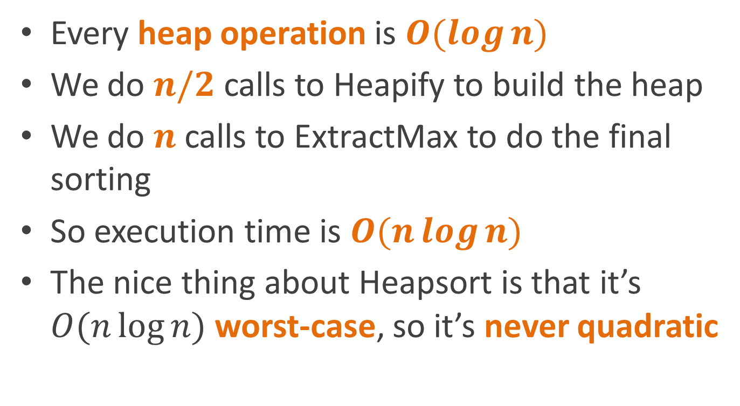
Analysis
Every heap operation is $O(\log{n)}$
We do $n/2$ calls to Heapify to build the heap
We do $n$ calls to ExtractMax to do the final sorting
So execution time is $O(n\log{n})$
The nice thing about Heapsort is that it’s $O(n\log{n)}$ worst-case, so it’s never quadratic

Slide 77
Reading
CLR Chapter 6 (Heapsort)

